Slide 1

Scrappy Market:
Milestone 1 Progress Report
From Natural Language to Structured Investigation
@
�0-_{r}-
060
71
0
IT7993 Capstone Spring 2026
.
)

Slide 2



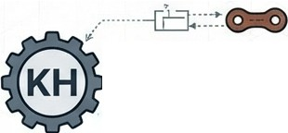







,,, , ,,, , Le:adership XIX:.,.,/_,.,/.,.,//,.,.,..,..//,.../,..----- -
THE PROJECT TEAM
..........,. .....,........
.
•
_ Matt Mackenny
Team Leader/ Planning & Dev
.. -........
Campbell Brothers
Product Manager/ Dev Alignment
........-....
Engineering
_
L
.
/
Henry Rondon
Dev Engineer (UI Focus)
Kamran Hall
Dev Engineer (Database Integration)
I ►
Jenish Chand
--+-+
Dev Engineer
j
'
Advisors
Mentor: Koteswara Rao Chirumamilla
Instructor: Ying Xie

Slide 3











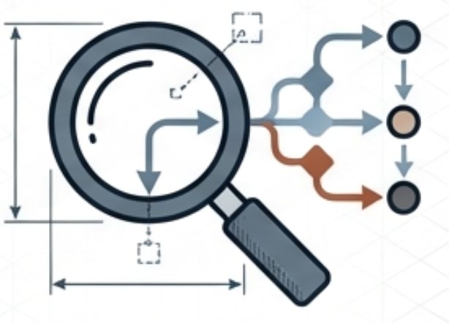



·1. .·......
........................................................................
I
•I
The Automated Data Engineer
'
•
r,
1·
I
!
0
••
- -
,.:
•�
·•·••·•
• •••
 | ₋- | -₋
 | - | -
·• +
Multi-Agent Al System
Natural Language to SQL
Explainable Reasoning

Slide 4

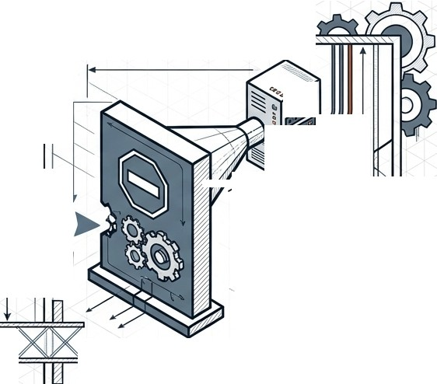







THE BUSINESS CHALLENGE: CYCLE CRAFT GEORGIA
// // .// /./ ./
r ,·-
AtIanta -.�..'.-.HI-H---h"'I.
�
"'�'I
Savannah
.. .,--.........
J-1
,.�,,, ,,
,:¥�
····-.�... •
..·•••••·...
_.•.₋,.,•.n_{-•U•} ?
; . ..•• ••..
; ••····••
.....u.....,.,-,5c;.
••
₌•- -un₋r₋r,
\,ff;�....... ....
hnU- ,.,., u, r • I"
...,c.,.........
' <J ()
(I I ^{,0}<)
•
,_⁻ .,
'�
.
-'
/
THE FRICTION GAP
THE BOTTLENECK
Bottleneck: Manual SQL requests take days.
Decision latency.
THE PROBLEM
Regional Managers need high-margin
data (E-bikes) -- instantly.

Slide 5









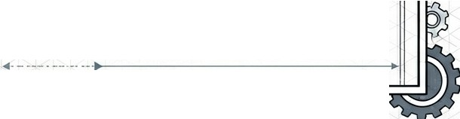
Requirements Specification
Functional Requirements
Intent Recognition
Non-Functional Requirements
Performance: 95% Uptime
(Parse ambiguous time/metrics)
SQL Generation
Reliability: Graceful error recovery
Security: Read-only access (SELECT only)
Tech: Python / LangGraph / Streamlit
/
(Syntactically correct MySQL)
'
Reasoning Visibility
(Explain the logic path)
⁻11-------------

Slide 6
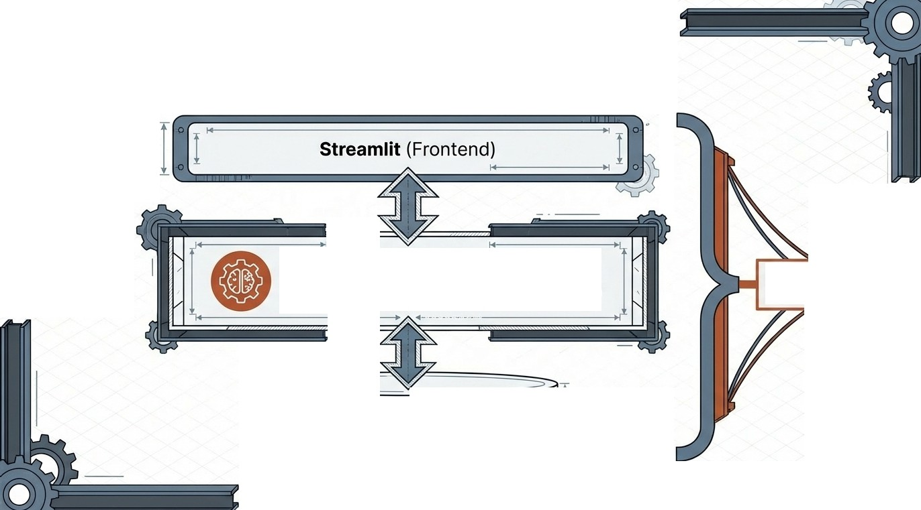
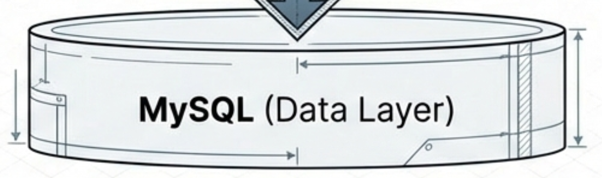

High-Level System Architecture
Ollama 3.1
(Reasoning)
LangGraph
(Agent Workflow)
Python-Based�
Backend
c
/
MySQL (Data Layer)
,....:.0--�

Slide 7
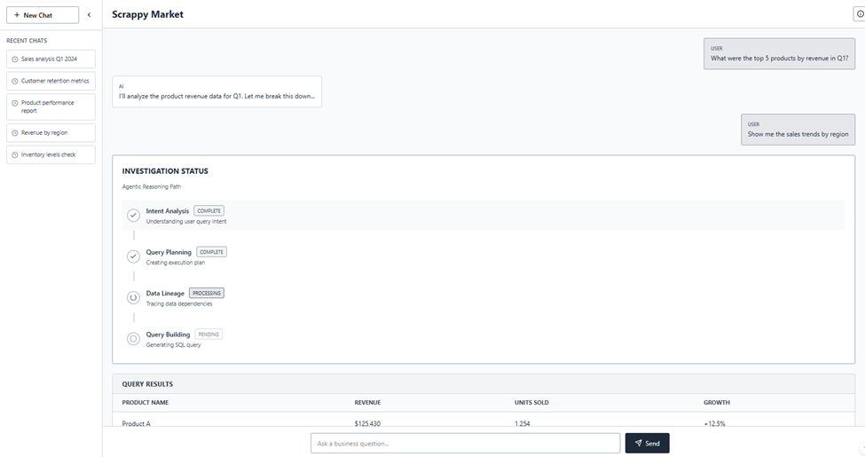
USER EXPERIENCE: THE INTERFACE

Slide 8

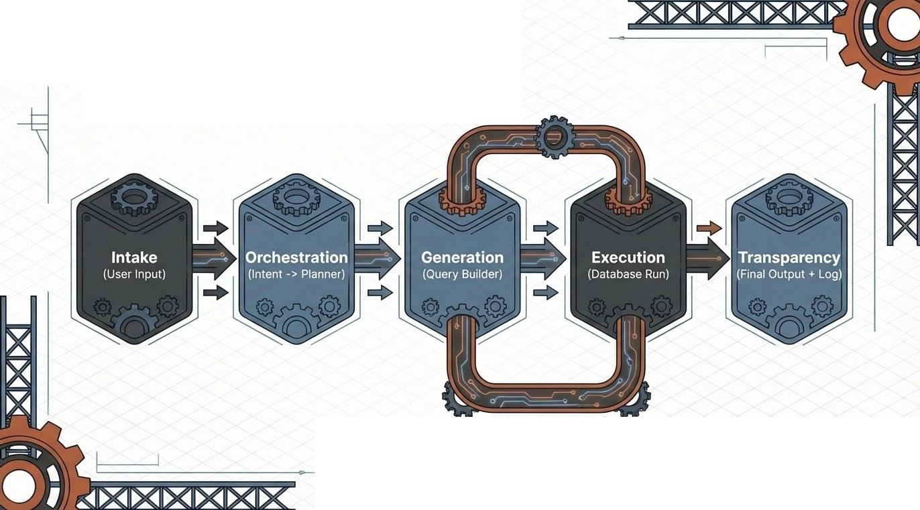
End-to-End User Flow
Self-Correction Loop
If Error-> Agent Rewrites SQL

Slide 9




I
'
I I
1
I
\
\..-,...... \
'',
The Agentic Workflow
--
'
'
Planner Agent
(The Strategist)
I
'
'
Intent Agent
(The Listener)
Query Builder
(The Translator)
Data Retrieval
(The Executor)
Summary Agent
(The Synthesizer)

Slide 10
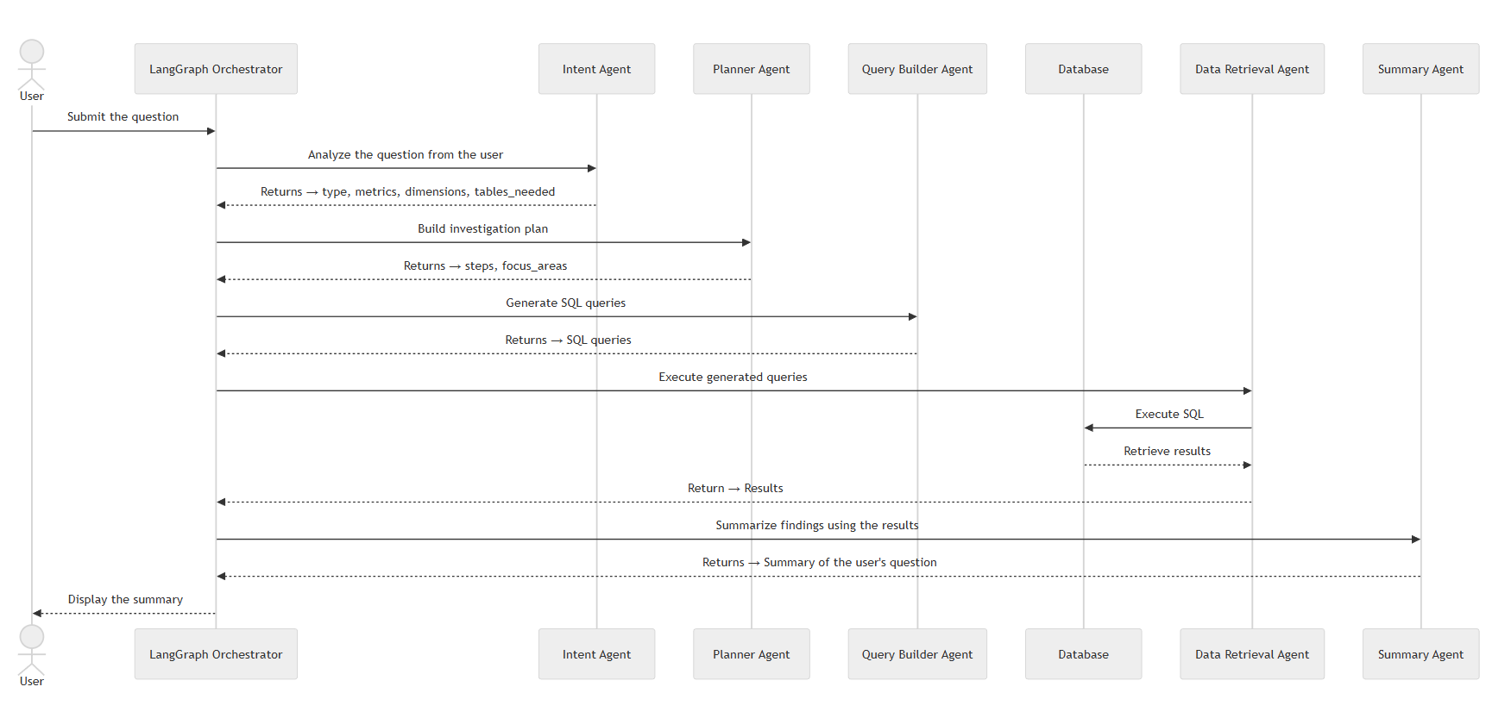
AGENTIC INTERACTION DIAGRAM

Slide 11

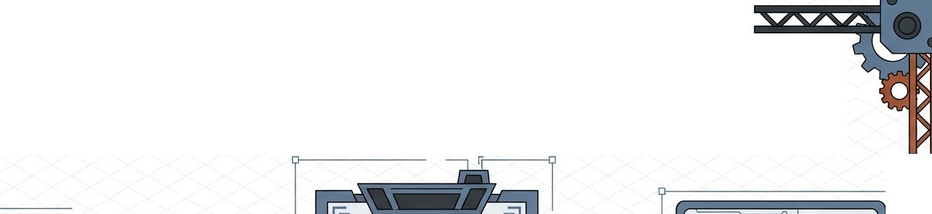
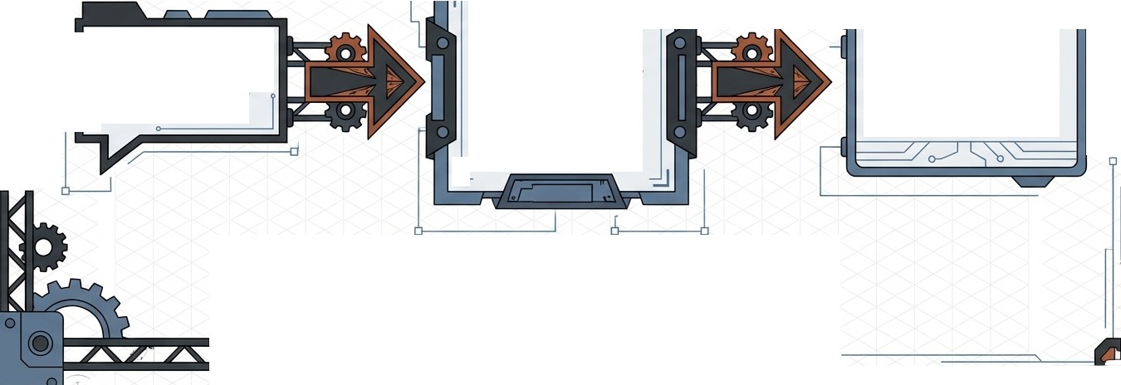
Agent Deep Dive: Translation Logic
l
{
O
Input: "Compare top
3 e-bike models in Atlanta vs Athens."
7
Category: 'E-bike', Locations: ['Atlanta', 'Athens'],
Action: 'Compare', Limit: 3
SELECT* FROM Sales JOIN Products ON...
WHERE Category= 'E-Bike' AND City IN {'Atlanta', 'Athens')...
L
}
L!:

Slide 12

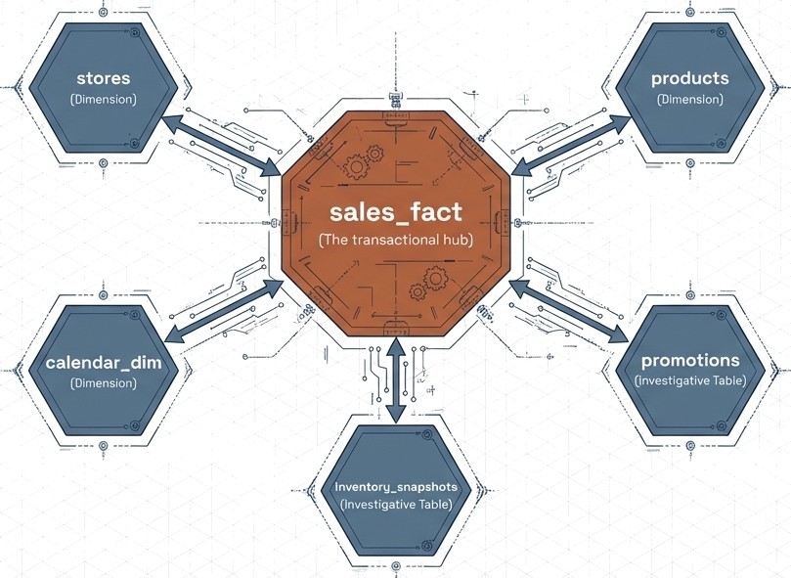
Designed for Investigative Logic testing, not
just storage.

Slide 13
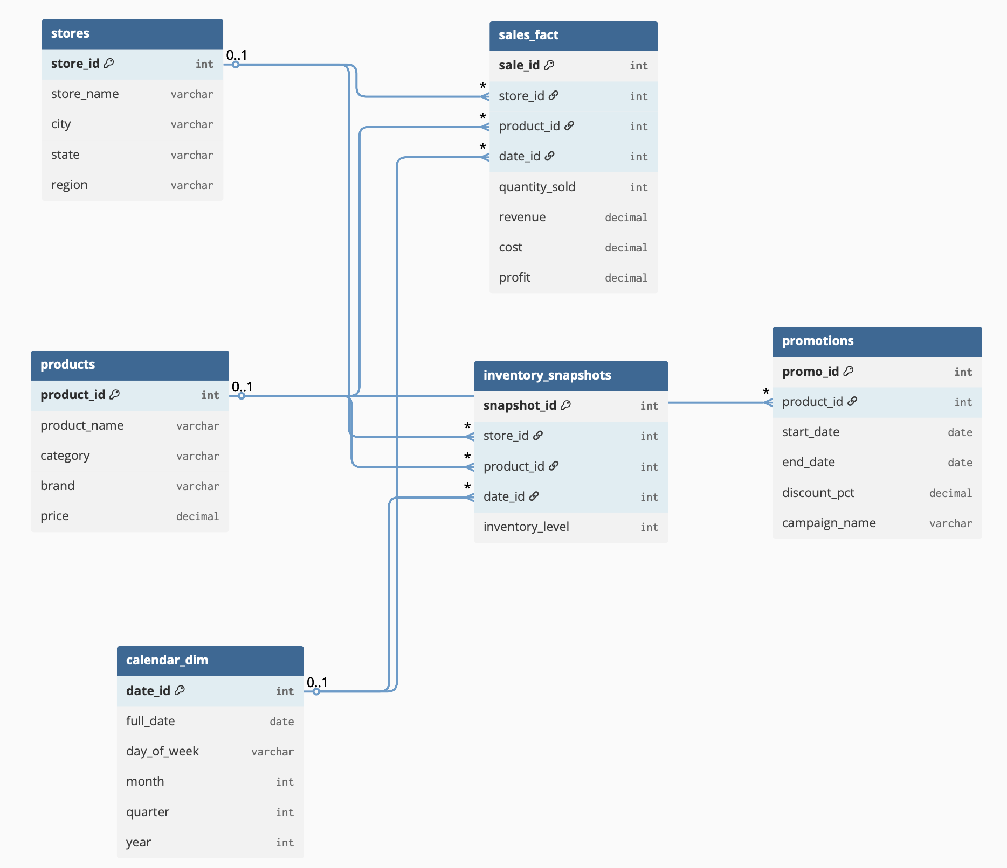
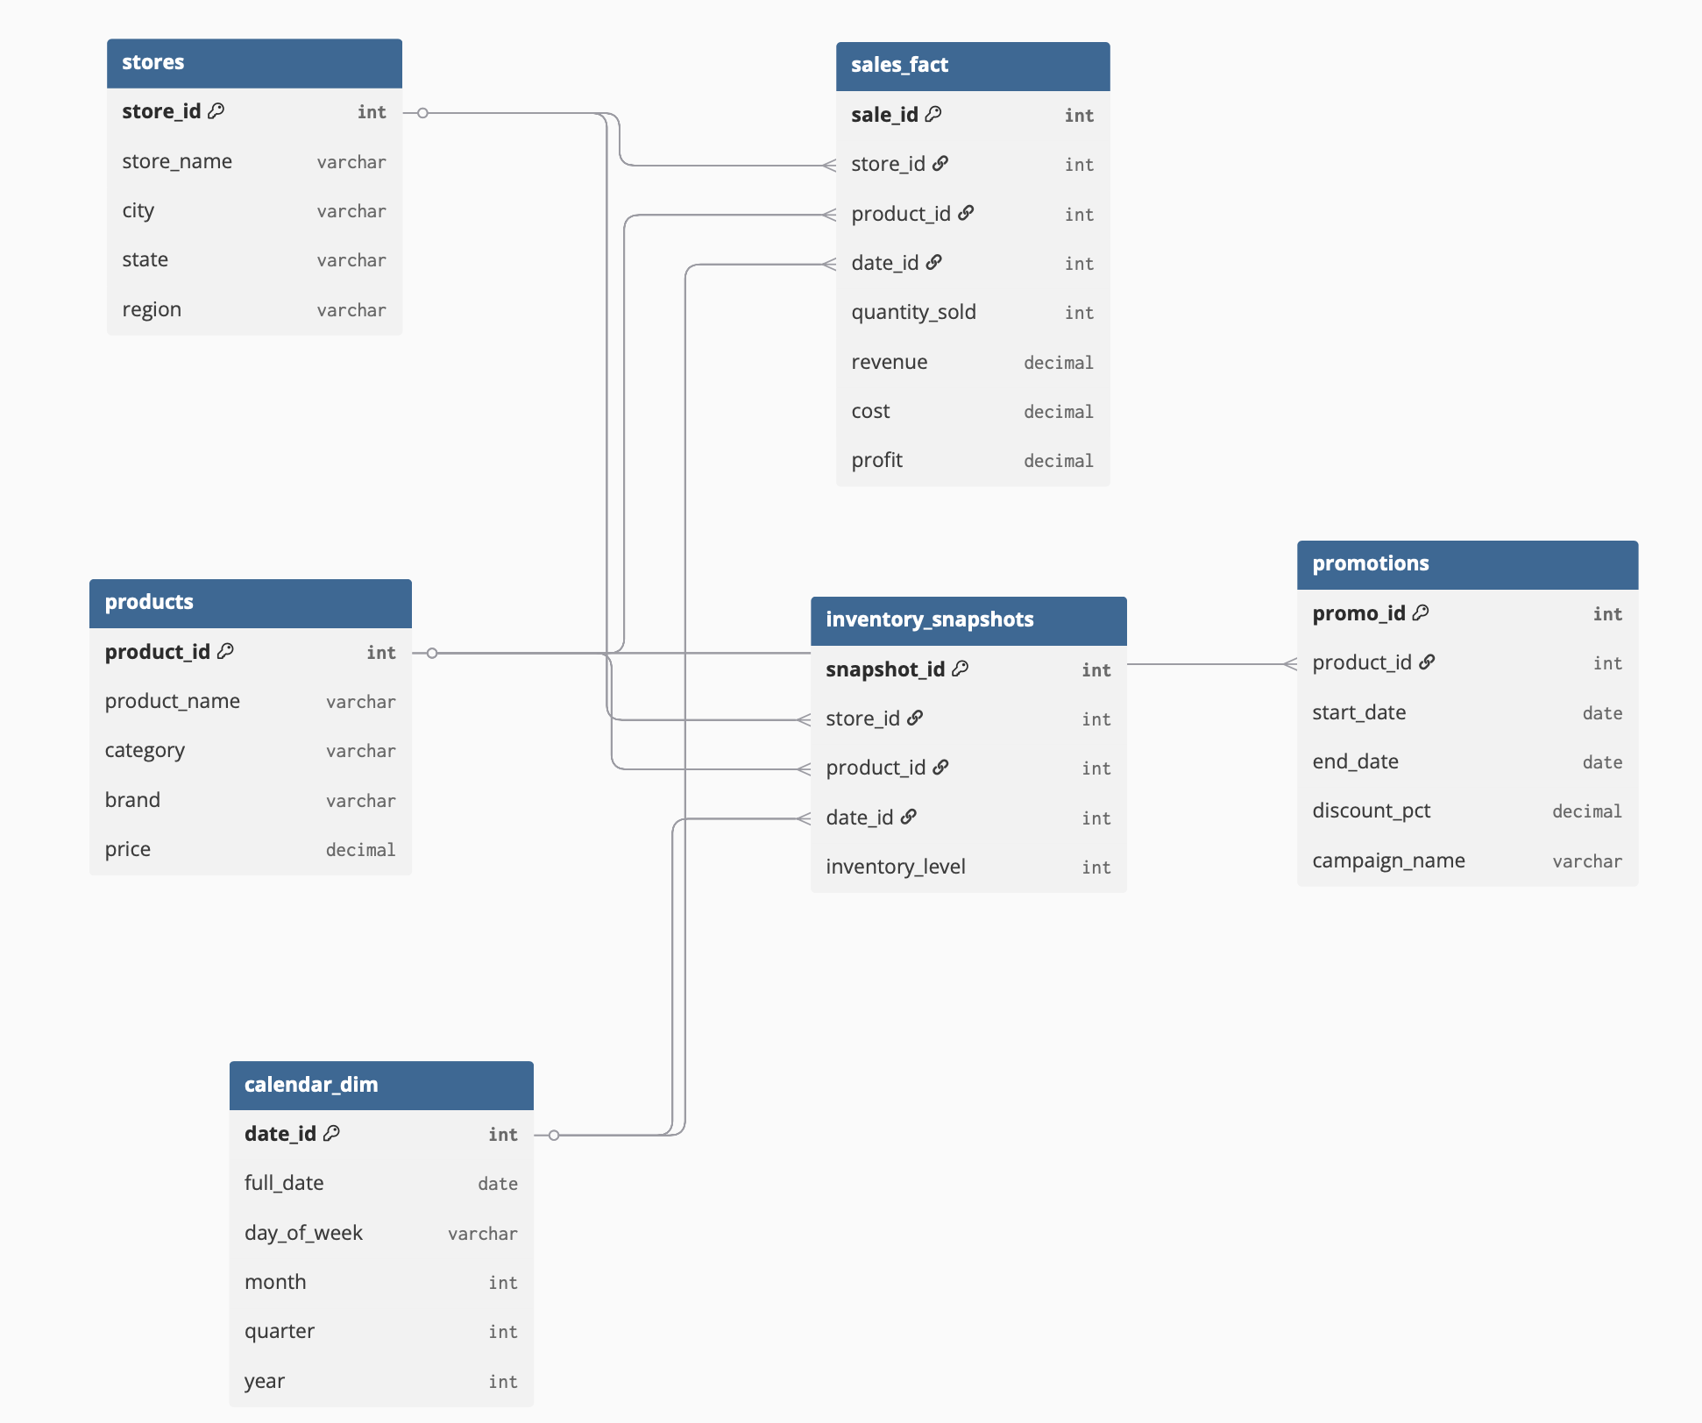

Slide 14

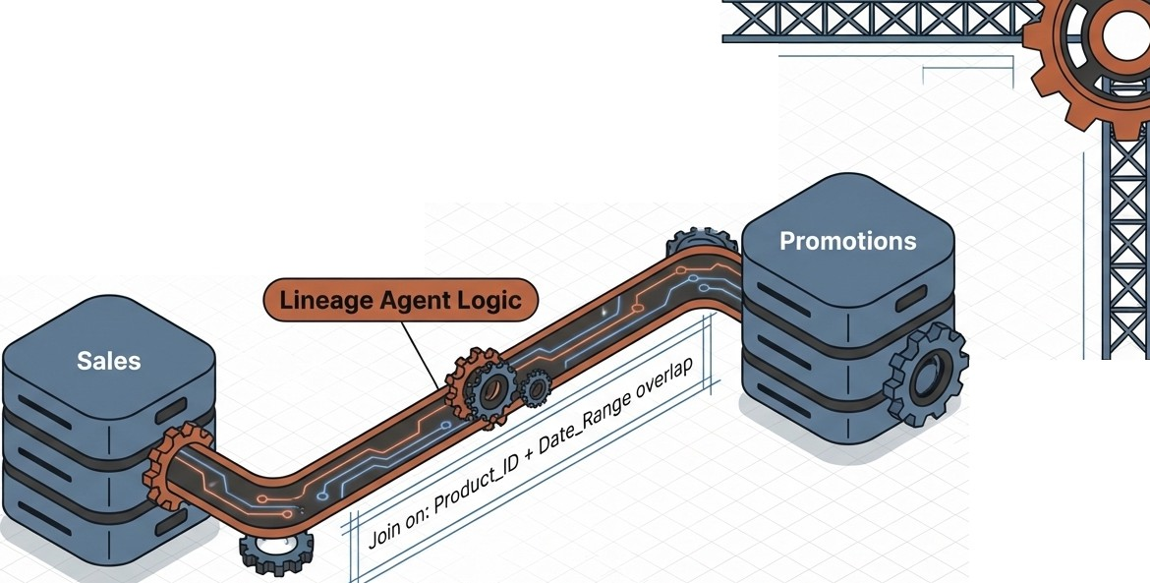



Data Lineage & Logic Mapping
Question: "What was the impact of promotions on sales?"
This demonstrates that the system validates the relationship before writing the code.

Slide 15



Project Roadmap
Feb 22 - Milestone 1
Mar 22 - Milestone 2
Apr 19 - Milestone 3
Requirements
& Design
Core Agent Dev
& Integration
Full System Integration

Slide 16





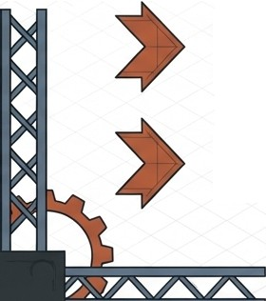
Summary & Next Steps
Design Complete: Architecture, Schema, and UI defined.
Foundation Laid: Synthetic Data strategy approved.
Next Action: Shifting from Design to Python Development.
Focus: Building the Intent and Query Builder Agents.

Slide 17







•
o
•
Scrappy Market Capstone Project
Thank you.

